Slide 1


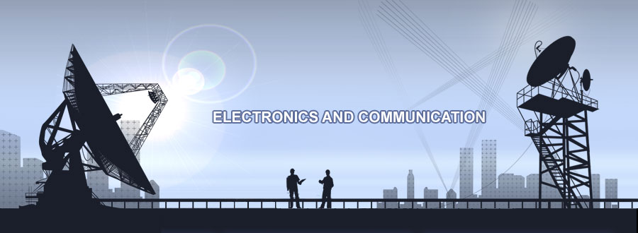

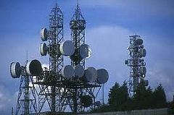
ELNG 307 – ANALOG AND DIGITAL COMMUNICATIONS

Slide 2
University of Energy and Natural Resources, Sunyani
Dept. of Computer & Electrical Eng.
ELNG 307 – ANALOG AND DIGITAL COMMUNICATIONS
Tweneboah-Koduah S.

Slide 3
Chapter 0 – Overview of course

Slide 4
Course Outline
Introduction to Communications Systems
Probability and random processes
Noise and Linear system analysis
Amplitude Modulation
Single-Sideband Techniques
Double-Sideband Techniques
Linear Modulation
Angle Modulation
Pulse Modulation
Effect of Noise in Communication Systems
Analogue Radio Receivers
Digital Modulation
Telecommunication, Communication Systems

Slide 5
Course Objectives
Demonstrate knowledge and understanding in basic concept in analogue and digital communication
Understand the basic requirements of communication systems
Understand communication terminology and impairment of effective communication
Understand the implementation and limitations of modulation techniques
Future of electronic communication systems, etc.
Part I: Intro to communication systems
Part II: Signal sampling and spectral analysis
Part III: Modulation techniques
Part IV: Noise in communication systems
Part V: Analogue radio receivers

Slide 6
References
All contents or materials found in this booklet not limited to images or figures can be found in the following recommended textbooks
  Lathi, B.P. and Ding, Zhi, Modem Digital and Analog Communication Systems, Oxford University Press, Fourth Edition, 2009
  Proakis, John G. Digital Communications. 4th ed. New York, NY: McGraw-Hill, 2000. ISBN: 9780072321111.
  Proakis, John G. and Masoud Salehi Communications System Engieering. 2nd ed. Upper Saddle River, NJ: Prentice Hall, 2001. ISBN: 9780130617934
  S. Haykin, Communication Systems, Wiley, 2001
  L.W. Couch II, Digital and Analog Communication Systems, Prentice-Hall, 2001

Slide 7
PART ONE – Introduction to Communication Systems
Quote: This mind is not an empty vessel to be filled but a powerhouse to be ignited
– Plutarch

Slide 8
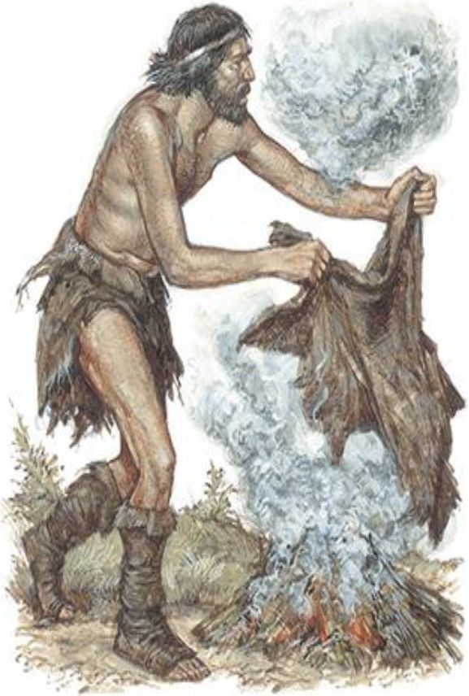
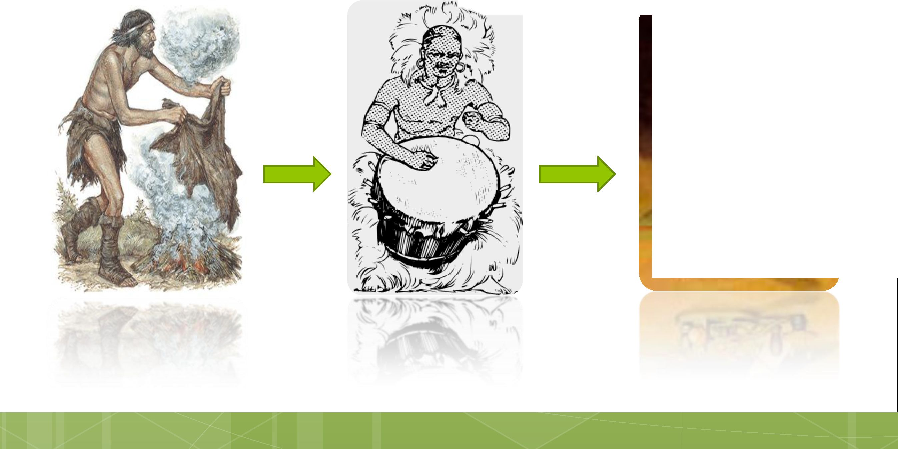
Introduction to Communication Systems
Communication systems are designed to transmit information from one place to another
Smoke
Signal
Tribal
Drum
Bird
Communication
Multi-hop
Ad Hoc
Morse Code
BC
…………………………Timeline…………………………
AD
Current Time
Notes:
Beats drum to attract people’s attention, then pass on mayor’s message to the city
Put a bait on an envelope containing message to entice a bird to carry it to another geographical place
A line of shouting men standing on heights conveys king’s messages from the capital to remote provinces of the empire

Slide 9
Introduction to Communication Systems
What are communication systems?
  systems designed for the purpose of transmission and reception of information
Electrical engineer is concern about solving communication and electric energy problems such as computers, electrical and electronic circuits, electronic devices, photonics, electromagnetics, etc.
Areas of application – Analog communication
  Old telephone networks
  Most television broadcasting at present
  Radio broadcasting
  Digital data transmission – analog channel
Notes:
Communication systems are distinctly different from electric energy.
In electric energy, the waveforms are usually known and electrical engineer is concerned with designing system for minimum energy loss.
Whereas in communication systems, the signal present at the sink is unknown until it is received at the sink.

Slide 10
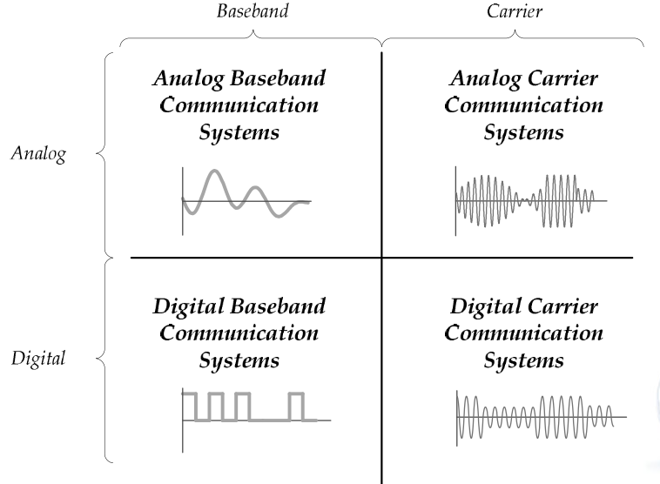
Types of Communication Systems and Sources
Communication Systems are classified based on the type of signal sent on the Channel
Analog Source
  information source produces messages that are defined within a continuum. i.e. analog messages are characterized by data whole value vary over continuous range
A digital source of information produces a finite set of possible messages

Slide 11
Transmission Modes
Simplex (SX) – one direction only, i.e. the receiver only receives without sending back acknowledgement e.g. TV
Half Duplex (HDX) – both directions but not at the same time. At a point in time the transmitter becomes the receiver and vice versa e.g. walkie-talkie
Full Duplex (FDX) – transmit and receive simultaneously between two stations at same time. No need to switch modes as HDX. e.g. standard telephone system
Full/Full Duplex (F/FDX) - transmit and receive simultaneously but not necessarily just between two stations, e.g. data communications circuits

Slide 12
Basic Structure of Communication System
Three basic elements
Transmitter: converts message into a form suitable for transmission.
Channel: the physical medium, introduces distortion, noise, interference, etc.
Receiver: reconstruct a recognizable form of the message
Notes:
Modulation ➔ is the process of changing some characteristics such as amplitude, frequency and/or phase of a carrier wave in accordance with the instantaneous value of the modulating signal.
➔Transmitter is made up of oscillators, amplifiers, tuned circuits and filters, modulators, frequency mixers, frequency synthesizers, and other circuits
➔Receivers contain amplifiers, oscillators, mixers, tuned circuits and filters, and a demodulator or detector that recovers the original intelligence signal from the modulated carrier

Slide 13
Basic Structure of Communication System
Transmitter
Collection of electronic circuits designed converts electrical signal into a form suitable for transmission based on the characteristics of the transmission channel.
The transmitter performs matching of message signal to the channel in a process called modulation.
The modulation process translates the information signal to frequencies that match the allocation of the channel.

Slide 14
Transmitter
What factors influence the choice of modulation, FM, AM, etc?
The amount of bandwidth allocated
The types of noise and interference that the signal encounters in transmission
Transmitter / Receiver type

Slide 15
Communication Channel
The channel is central to the operation of a communication system
  Linear (e.g., mobile radio) or nonlinear (e.g., satellite)
  Time invariant (e.g., fiber) or time varying (e.g., mobile radio)
Pursuit for wider bandwidth
  Copper wire: 1 MHz
  Coaxial cable: 100 MHz
  Microwave: GHz
  Optical fiber: THz
    Highest capacity among all practical signals

Slide 16
Communication Channels
Communication medium poses a serious challenge such as distortion, interference, and noise to the transmitted signal
Transmitted signal get corrupted in a random manner by a variety of ways (additive noise ) as they pass through the channel
In the design of a communication system, the system designer works with mathematical models
that statistically characterize the signal distortion encountered on physical channels.
Notes:
The channel:
It acts partly as a filter to attenuate the signal and distort the waveform.
The attenuation increases with the length and property of the channel.
The distortion occurs due to different amount of attenuation and phase shift suffered by different frequency components of the signal.
Additive noise (or thermal noises) generated at the front end of the receiver, where signal amplification is performed.

Slide 17
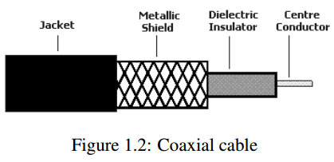
Types of communication channels
Conducting pair of wires
  Commonly use in telephony and telegraphy – transmitter and receiver is physical wired to each other.
Coaxial cables
  Provide greater bandwidth, lower losses and minimal crosstalk

Slide 18
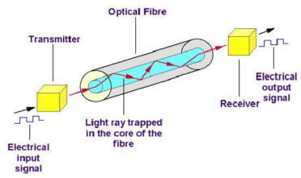
Types of communication channels
Fiber-optic cables
  Transmission of information using light pulses
  The main advantage of these cables is that they provide large bandwidth
  The fibre-optic cable can carry information such as voice, video and computer data
  The two most commonly used light sources in fibre optic
  systems are LEDs and semiconductor lasers
  Communication system with fibre optic cables are free from interference, unlike coaxial cables
Benefits of fibre-optic cables over conventional electrical cables → check handout

Slide 19
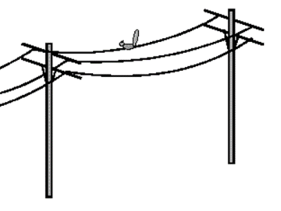
Types of communication channels
Transmission lines
  The practical examples of the electric waves, which are transmitted along the transmission lines are the electrical power signals and the telephone messages
  Transmission lines and waveguides serve as
  guided structure used to guide the propagation or transmission of energy from the source
  to the load
Figure 1.3: Open wire transmission line

Slide 20
Types of communication channels
Radio communication
  Radio communication is a wireless communication, requiring no physical wires between transmitter and receiver to carry the signal
  Have frequencies ranging from 300 GHz to as low as
  3kHz, and corresponding wavelengths from 1 millimeter to 100 kilometers
  Requires two antennas – transmitter and receiver
  The medium attenuates the signal and causes it to
  appear much lower in amplitude at the receiver
  Radio communication makes it possible to communication over very long distances, even from earth
  to moon.

Slide 21
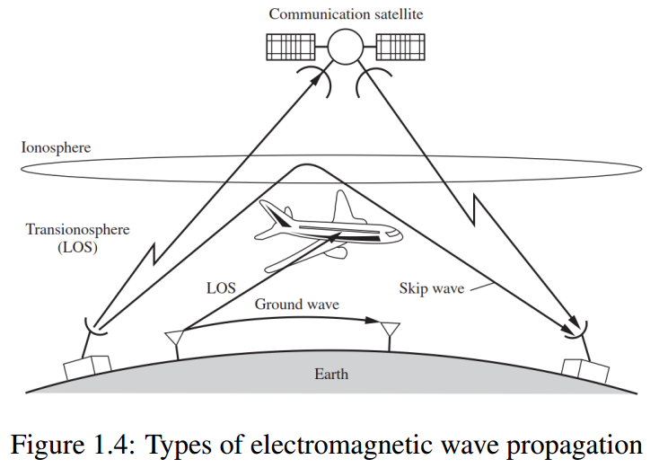
Electromagnetic wave propagation
Electromagnetic energy is coupled to the propagation medium by an antenna which serves as the radiator
Propagation mode is grouped into
  ground-wave propagation
  sky-wave propagation
  line-of-sight (LOS) propagation as indicated in Figure 1.4
Notes:
The physical size and the configuration of the antenna depend primarily on the frequency of operation
To obtain efficient radiation of electromagnetic energy, the antenna must be longer than 1/10 of the wavelength

Slide 22
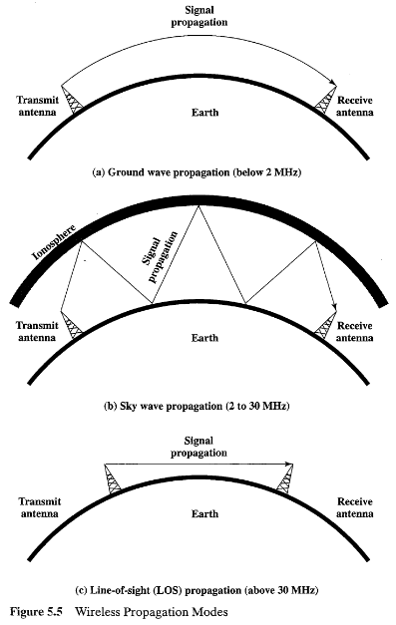
Propagation mode
Ground-wave
  Frequency range in MF band (0.3 to 3 MHz)
  Typical application is AM and maritime radio broadcasting
Sky-wave
  Results from transmitted signals being reflected or refracted from the ionosphere.
Line-of-sight (LOS)
  Terrestrial communication
  VHF and UHF frequency bands
  Attenuation is a worrying factor in LOS communication
Notes:
Ionosphere consists of several layers of charged particles ranging in altitude from 30
to 250 miles above the surface of the earth

Slide 23
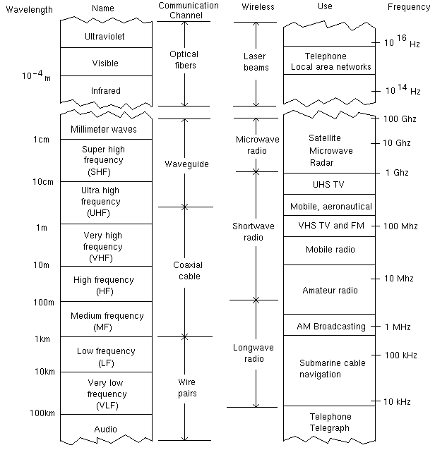
ADC and Transmission Channel cont’d
EM Spectrum

Slide 24
Noise in Communication Channel
Noise is random, undesirable electric energy that enters the communication system via the medium and interferes with the transmitted message.
Noise is one of the serious problems of electronic
communication but can be controlled
There are ways to deal with noise, and reduce the possibility of degradation of signal due to noise.

Slide 25
Noise in Communication Channel
Unavoidable presence of noise in the channel
  Noise refers to unwanted waves that disturb communications
  Signal is contaminated by noise along the path.
External noise: interference from nearby channels, man made noise, natural noise...
Internal noise: thermal noise, random emission... in electronic devices.
Noise is one of the basic factors that set limits on communications.
We shall look at
  Addictive noise channel
  Linear filter channel
  Linear time-variant channel

Slide 26
Receiver
A receiver is a collection of electronic circuits designed to convert the signal from the channel
back to the original information.
It consists of amplifier, detector, mixer, oscillator, transducer, tuned circuits, filters and so on.
Its operations include amplification to compensate for transmission loss, and demodulation, decoding and filtering to reverse the signal-processing
performed at the transmitter.

Slide 27
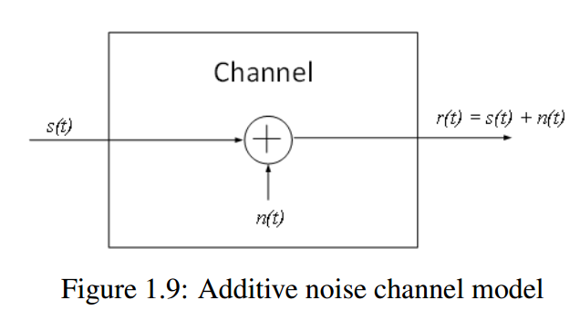
Mathematical Models of Communication Channels
Additive noise channel model

Slide 28
Mathematical Models of Communication Channels
The linear filter channel
  In some physical channels such as wireline telephone channels, filters are used to ensure that the transmitted signals do not exceed specified bandwidth limitations and, thus, do not interfere with one another.
  Such channels are generally characterized mathematically as linear filter channels with additive noise

Slide 29
Channel Bandwidth and Info. Capacity
The fundamental parameters that control the rate and quality of information transmission are the channel bandwidth B and the signal power S
The bandwidth of a channel is the range of frequencies that it can transmit with reasonable fidelity
Signal power S relate to
  Quality of information ➔ Increasing S, reduces the effect of channel noise.
  Bandwidth B, ➔ S and B are exchangeable i.e. increasing one (may) reduces the other
SNR is proportional to S ➔ SNR are interchangeable
Notes:
➔ SNR2 = SNR1^(B1/B2). Thus, if a given rate of information transmission requires a channel bandwidth B₁ and a signal-to-noise ratio SNR₁, then it is possible to transmit the same information over a channel bandwidth B₂ and a signal-to-noise ratio SNR₂

Slide 30
Channel Bandwidth and Info. Capacity cont’d
Thus, if we double the channel bandwidth, the required SNR is just a square root of the former SNR, and tripling the channel bandwidth reduces the corresponding SNR to just a cube root of the former SNR
  small increase in channel bandwidth has greater advantage in terms of reduced transmission power whereas large increase in transmitted power has marginal effect on situation where bandwidth has been reduced
  Hence, in practice, the exchange between B and SNR is usually in the sense of increasing B to reduce transmitted power, and rarely the other way around.

Slide 31
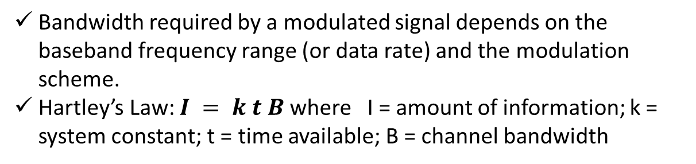
Channel Bandwidth and Info. Capacity
Information capacity, C of a channel is given by the Shannon’s equation
C describes the limitations imposed on communication by channel bandwidth and SNR
Defined as the maximum rate at which information can be transmitted across the channel without error
Bandwidth required by a modulated signal depends on the baseband frequency range (or data rate) and the modulation scheme.
Hartley’s Law: $I = k t B$ where I = amount of information; k = system constant; t = time available; B = channel bandwidth

